Slide 1

Influence of Environmental Provisions in the Decision-Making Process of Investor-State Arbitration: Viewing through Dworkin’s Lens
Sekander Zulker Nayeen
PhD Candidate, City, University of London
Additional District Judge, Bangladesh

Slide 2
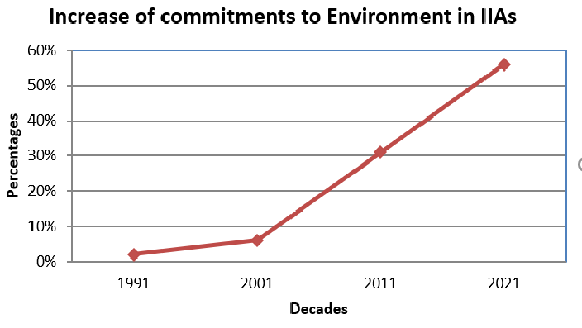
Post-1992 Rio Earth Summit
Source: Rodrigo Polanco, ‘Sustainable Development in Swiss International Investment Agreements’ (2021) 31 Swiss Review of International and European Law 211

Slide 3

Read the cases for finding the application of EPPs
Jude Law in the movie ‘Enemy at the Gate (2001)’

Slide 4
Reflections on the EPP’s application in investor-State arbitrations
Cases | IIAs | Environmental commitments | Tribunal’s approach
Metalclad v Mexico (2000) | NAFTA, 1992 | Preamble Right to regulate for environment. Non-regression Others | Investment protection Taking the land for Environmental purpose is the same as that of for school or hospital.
Methanex v US (2005) | NAFTA, 1992 | Ditto | Environmental Justifications considered. ​ Scientific evidence Transparent legislative proceedings No specific inducement for legitimate expectation.
Glamis Gold v US (2009) | NAFTA, 1992 | Ditto | Transparent legislative proceedings No specific inducement for legitimate expectation.
Crystallex v Venezuela (2016) | Canada- Venezuela BIT 1996 | Right to regulate for environment | Right to regulate for environmental protection was considered. But, decided against the State based on the transparency issue in denying the permit.
Eco Oro v Colombia (2021) | Canada- Colombia FTA 2008 [New Generation Treaty] | Non-regression, Corporate Social Responsibility, Right to regulate for environment will not constitute expropriation. | Tribunal decided that although the State’s environmental measure did not breach the investment protection standards, it does not mean that the investor will be disentitled from claiming the payment of compensation.

Slide 5
Findings
The existence of environmental commitment in the concerned IIA is immaterial to obtain the tribunal's decision in favour of the State's regulatory power for environmental protection.
Tribunals assess the reasonableness of environmental measures through the lens of investment protection standards, not from the lens of environmental protection.

Slide 6
Ronald Dworkin, Taking Rights Seriously (London: 1996)
Law= Rules, Principles, and Policies
Law comprises various rules (for example, rules of international law), which set some standards to decide.
Principles and policies generally are not ‘rules’ although they set some standards.
Achieving some policies (goals) could be framed as principles.
Functions of rules and principles
Rule directly influences the decision-making process, and principle influences the decision by testing its justness, fairness and moral dimension.
A rule cannot lead the tribunal to a particular decision if it contradicts a principle.
Contradictory principles work towards the decision-making based on their relative weights.

Slide 7
Application of principles for environmental protection
NAFTA, Preamble: Parties agreed to UNDERTAKE everything in a manner consistent with environmental protection and conservation; PROMOTE sustainable development; STRENGTHEN the development and enforcement of environmental laws and regulations.
Canada- Venezuela BIT: ‘…nothing in this Agreement shall be construed to prevent a Contracting Party from adopting or maintaining … environmental measures…’.
Canada- Colombia FTA, Non-regression: The Parties recognize that it is inappropriate to encourage investment by relaxing domestic health, safety or environmental measures.
-----------------------------------------------------------------------------------
Article 31(1)(2), VCLT: Principles agreed in Preamble shall be applied in interpretation.
Lastly, decision should be reached based on the relative weights of the principles (for example, legitimate expectation v. non-regression).

Slide 8
The City Law School
Northampton Square Campus
City University London
Northampton Square
London
EC1V 0HB
T: +44 (0)20 7040 3309
E: law@city.ac.uk
Thanks for your patience hearing

